Slide 1
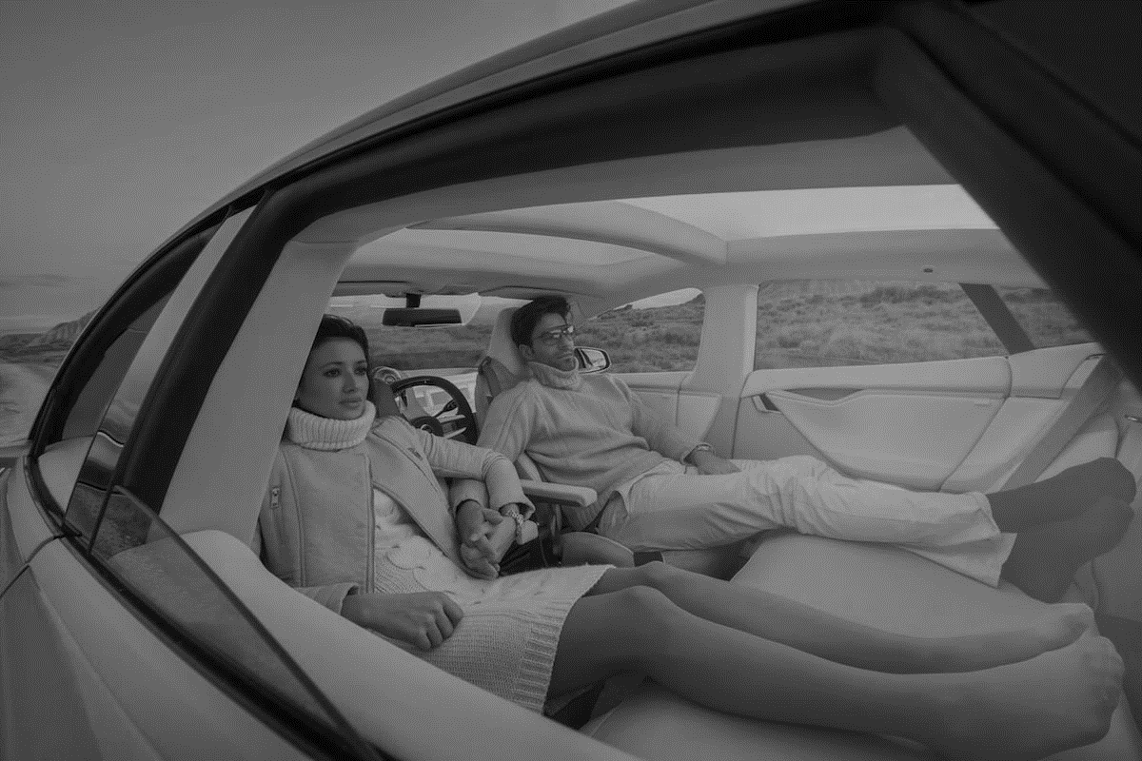
THE USER MOBILITY PROFILE
ENABLING A USER-CENTRIC TRANSPORTATION EXPERIENCE

Slide 2
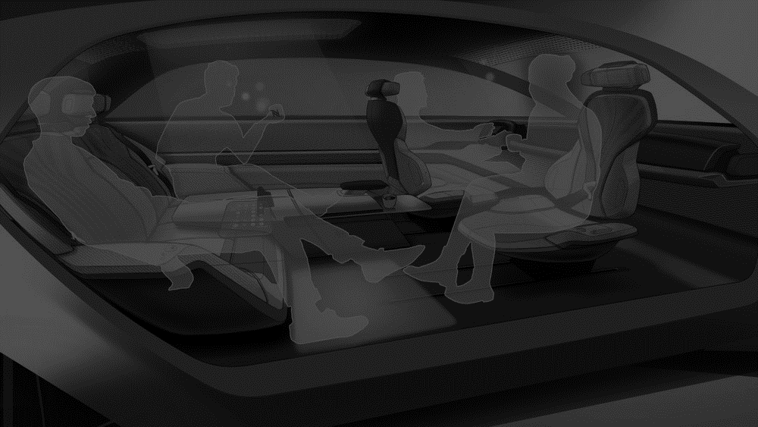
THE USER MOBILITY PROFILE
WHAT IT IS
A DISTRIBUTED PLATFORM- AND OPERATING SYSTEM-INDEPENDENT PROFILING SYSTEM FOR PASSENGERS OF AUTONOMOUS VEHICLES
THE COLLECTION OF INFORMATION ASSOCIATED WITH A PASSENGER IN AN AUTONOMOUS VEHICLE
EACH PASSENGER IN AN AUTONOMOUS VEHICLE CAN BE REFERENCED VIA ITS OWN USER MOBILITY PROFILE (UMP)

Slide 3
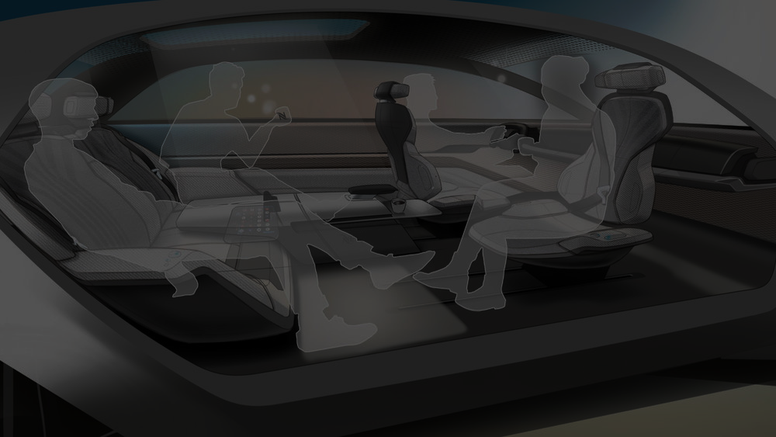

Carl
Mary
Bob
John
Mary’s UMP
Carl’s UMP
Bob’s UMP
John’s UMP

Slide 4
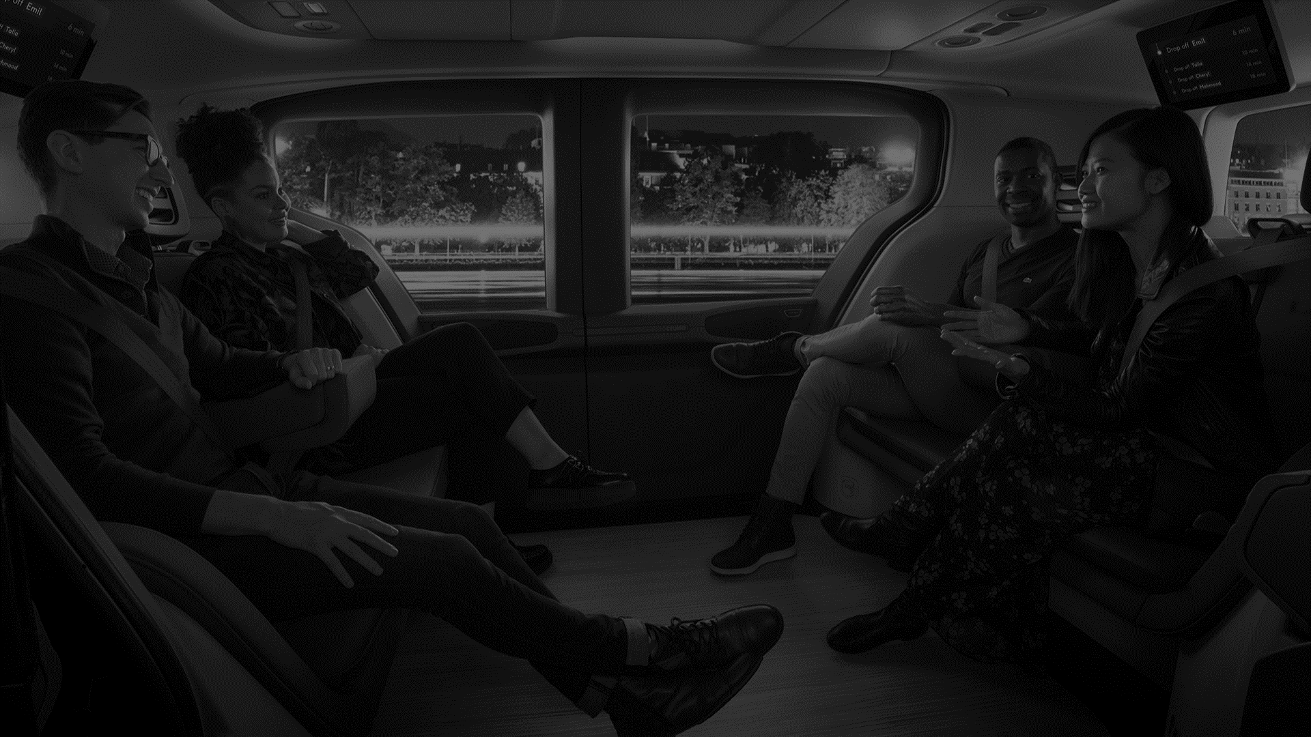





THE USER MOBILITY PROFILE
WHAT IT CONTAINS
MODULAR AND EXTENSIBLE ARCHITECTURE
USER MOBILITY PROFILE
USER PERSONAL
PROFILE
USER TRAVEL
PROFILE
USER SERVICES PROFILE
USER SOCIAL PROFILE

Slide 5
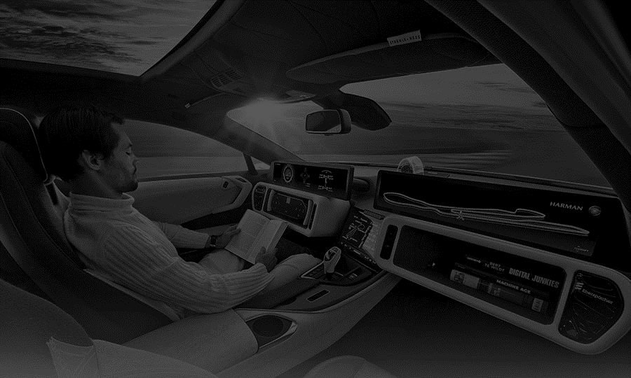
THE USER MOBILITY PROFILE
USER PERSONAL PROFILE
WHAT IT CONTAINS
ALL USER PERSONAL INFORMATION THAT DOES NOT BELONG TO ANOTHER CATEGORY
PERSONAL DETAILS
Name
Surname
Age
…
USED FOR THE UMP RETRIEVAL PROCEDURE
BIOMETRIC FEATURES
Face
Voice
Fingerprint
Weight
PAYMENT METHODS
Credit Card
Debit Card
…

Slide 6
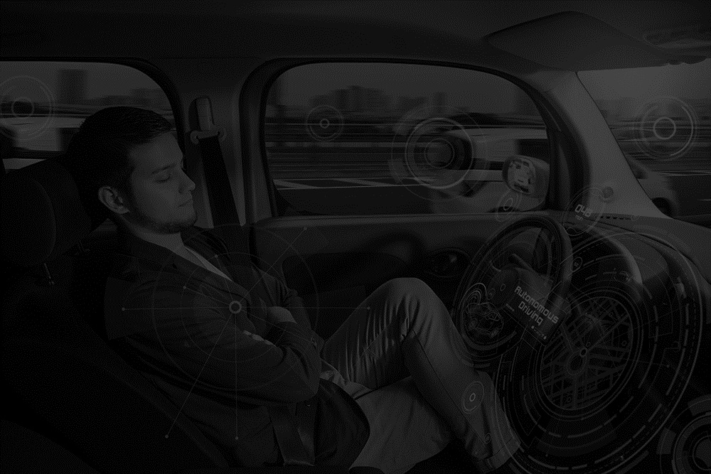


THE USER MOBILITY PROFILE
USER TRAVEL PROFILE
WHAT IT CONTAINS
ALL USER TRAVELLING AND AMBIENCE PREFERENCES
DIVIDED INTO PLATFORM-INDEPENDENT AND PLATFORM-DEPENDENT
PLATFORM INDEPENDENT
Driving Style
Points of Interest
Location History
Seat Configuration
Temperature
Lighting Level
PLATFORM DEPENDENT 1
Preference 1
Preference 2
…
Preference M
.
.
.
PLATFORM DEPENDENT N
Preference 1
Preference 2
…
Preference K
VENDOR SERVICES EXTENSIBILITY

Slide 7


THE USER MOBILITY PROFILE
USER SERVICES PROFILE
WHAT IT CONTAINS
THE LIST OF ALL APPLICATIONS AND SERVICES THE USER IS SUBSCRIBED TO
DIVIDED INTO PLATFORM-INDEPENDENT AND PLATFORM-DEPENDENT
PLATFORM INDEPENDENT
Amazon Prime
Netflix
Sky
…
PLATFORM DEPENDENT 1
App 1
App 2
…
App M
App = {appName, downloadURL}
.
.
.
PLATFORM DEPENDENT N
App 1
App 2
…
App K

Slide 8



THE USER MOBILITY PROFILE
USER SOCIAL PROFILE
WHAT IT CONTAINS
A COLLECTION OF THE USER GENERAL INTERESTS AND PREFERENCES
A SELECTION OF THE USER SOCIAL MEDIA CONTENTS
USER GENERAL INTERESTS
Favourite Music Genre
Favourite Movies
Hobbies
Marital Status
SOCIAL MEDIA PLATFORM 1
Content 1
Content 2
…
Content M
.
.
.
SOCIAL MEDIA PLATFORM N
Content 1
Content 2
…
Content K

Slide 9

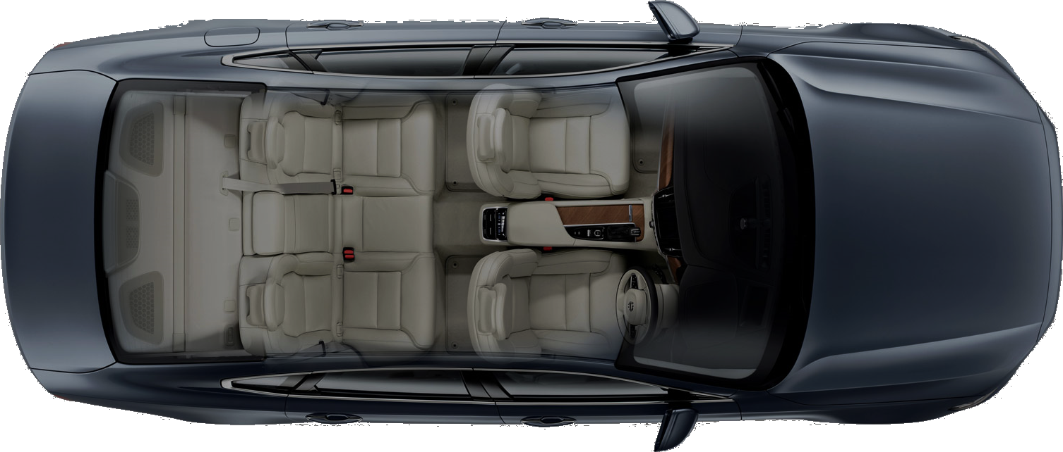



THE USER MOBILITY PROFILE
GLOBAL VS LOCAL UMP
GLOBAL USER MOBILITY PROFILE
The entire collection of the user information and preferences
LOCAL USER MOBILITY PROFILE
The subset of the user information and preferences applicable in the current context (platform-dependent)
USER
related
sync
CURRENT USER VEHICLE
CLOUD REPOSITORY

Slide 10
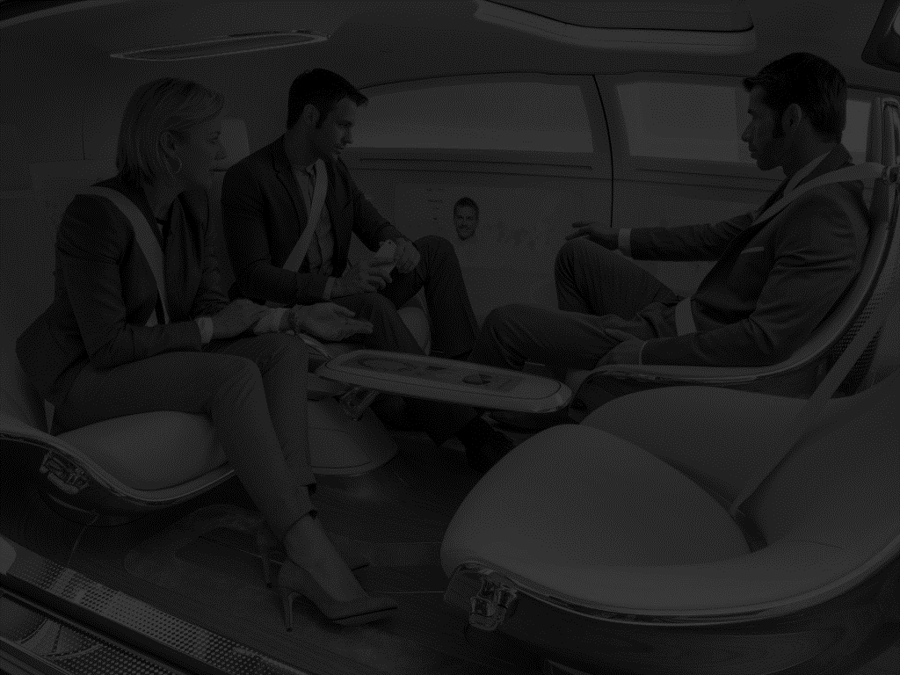
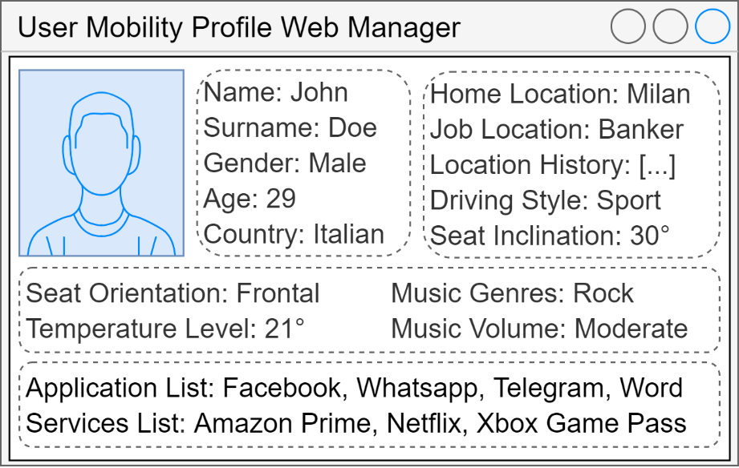



THE USER MOBILITY PROFILE
HOW IT WORKS — PREMISES
THE PRE-EXISTING USER GLOBAL UMP IS STORED IN A CLOUD REPOSITORY
The user can initialize and manage the contents and permissions of the information stored within its UMP through a web interface.
THE CAR IS EQUIPPED WITH BIOMETRIC SENSORS
camera
Such as face-recognition cameras, microphones and more, sensors that continuously scan the passenger compartment for user biometric input.
Microphone
camera

Slide 11


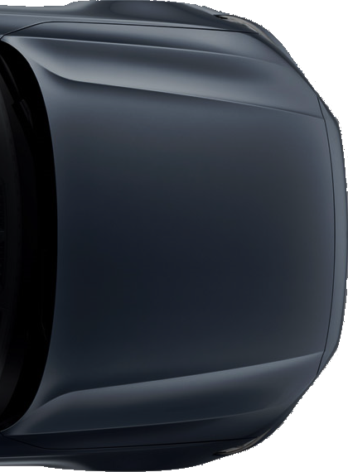

THE USER MOBILITY PROFILE
HOW IT WORKS
Carl
USER BIOMETRIC FEATURES SAMPLING
Whether as part of an explicit authentication process when entering the vehicle or shortly thereafter, due to the continuous scanning of the biometric sensors, one or more of the user biometric features is collected and sent to a local User Mobility Profile Manager (UMPM) module.
UMPM
USER LOCAL BIOMETRIC IDENTIFICATION
Within the UMPM the sampled biometric features are matched against the corresponding features found in each of the UMPs currently stored in the module, with the purpose of identifying the user and matching such input, and the possibly associated command, with his or her set of information and preferences.
UMPM

Slide 12




THE USER MOBILITY PROFILE
HOW IT WORKS
FORWARD UMP REQUEST TO THE CLOUD
UMP Request
UMPM
If a match for the biometric input was not found in the local UMPs, a temporary profile for such user is created and a request for retrieving the user UMP containing the biometric features and information on the car platform is forwarded to the cloud repository.
Cloud
Repository
USER CLOUD BIOMETRIC IDENTIFICATION
Cloud Repository
Within the cloud repository, similarly to what was performed in the car environment, the user biometric features are checked against the corresponding features stored in the entire collection of UMPs until a match is found.

Slide 13


THE USER MOBILITY PROFILE
HOW IT WORKS
CREATION OF THE LOCAL UMP
Cloud Repository
Once the user has been identified within the cloud, their local user mobility profile is crafted from their global profile by discarding all platform-dependent information that is not applicable in the vehicle currently occupied by the user.
UMP Request
RETURNING THE LOCAL UMP
UMPM
After its assembly, the user local mobility profile is returned to the requesting UMPM for it to be used within the car local environment.
Cloud
Repository

Slide 14



THE USER MOBILITY PROFILE
HOW IT WORKS
RETRIEVAL OF THE USER APPLICATIONS
App 1 Request
As a new local profile is loaded within the UMPM, depending on the user and/or the car policies, each or in general a subset of the applications specified within their user services profile, along with their configuration, is retrieved from the internet and installed in the local environment.
UMPM
App 1
.
.
.
Internet
App N Request
App N
USING THE USER MOBILITY PROFILE
Carl
getHome
Location()
Go Home
Driving Control
In addition to biometric identification purposes the UMPM module enables the applications running in the local environment, given the appropriate permissions, to read and update the contents of the passengers' local profiles, allowing for their self-configuration according to the users' preferences.
UMPM
It’s Cold
Ambient Control
Bob
setFavourite Temperature()

Slide 15

THE USER MOBILITY PROFILE
HOW IT WORKS
SYNCHING THE USER MOBILITY PROFILE
Once the user leaves the vehicle, either explicitly or implicitly if their biometric features are not sampled within a given time interval, the information in their local UMP that was modified or added is sent to the cloud repository, where it will be merged with the user’s global mobility profile.
Carl
UMPM
Cloud Repository

Slide 16

[1] Shervin Minaee, Amirali Abdolrashidi, Hang Su, Mohammed Bennamoun, David Zhang, Biometric Recognition Using Deep Learning: A Survey, Cornell University (2020)
BIOMETRIC RECOGNITION SYSTEMS
[2] Tim Sloane, David Nelyubin, Biometrics: Driven by Standardized Authentication, Adopted by Consumers, Mercator Advisory Group (2020)
[3] Kamran Siddique, Zahid Akhtar, Yangwoo Kim, Biometrics vs passwords: a modern version of the tortoise and the hare (2017)
[4] Antoaneta Roussi, Resisting the Rise of Facial Recognition, Nature (2020)
SEAMLESS AUTHENTICATION
INCREASING USER POPULARITY
State-of-the-art solutions are based upon deep neural networks, and consist in classifying one or more of the user physical features, such as face, iris, ear shape, speech, fingerprint, weight, etc.¹
Market researches forecast an increment in the smartphone user base adopting biometric recognition systems as their primary authentication method from the current 41% to 66% in 2024²
ADVANTAGES:
DISADVANTAGES:
Reduced user cognitive effort in the authentication process
No risk of forgetting passwords or losing authentication tokens
More secure than the average user-selected password³
User features variance susceptibility (eyeglasses, aging, etc.)
Requires more computational capabilities than traditional authentication systems, especially for real-time processing
Reliability strictly dependent on the sensors’ accuracy
Privacy issues due to the use of the user physical features
Lack of a well-defined regulatory framework⁴

Slide 17






NEURAL CLASSIFIER
REAL WORLD SCENARIO
PCA
UMP
Photo
Features Extractor
Neural Classifier
THE PCA FEATURES EXTRACTED CAN BE EXCHANGED BETWEEN THE VEHICLE AND THE CLOUD
COMPANIES IMPLEMENTING THE UMP NEEDS ALSO TO IMPLEMENT A PCA EXTRACTOR OR THE SYSTEM COULD IMPLEMENT AN UNIQUE COMMON PCA FOR ALL THE IMPLEMENTATIONS.

Slide 18

THE USER MOBILITY PROFILE
PROJECT SPECIFICATION

Slide 19

1/4
FUNCTIONAL REQUIREMENTS
THE SYSTEM SHALL DEFINE A MODULAR DATA STRUCTURE FOR HOLDING THE SET OF INFORMATION ASSOCIATED TO PASSENGERS OF AUTONOMOUS VEHICLES
Such data structure, to be named “User Mobility Profile (UMP)” , must be organized into the following modules:
A "User Personal Profile (UPP)" module, holding the set of user personal information such as the name, surname, age, address, gender, payment methods, as well as a set of their biometric features including but not limited to their iris, face and speech patterns.
A “User Travel Profile (UTP)” module, containing all user travelling and ambience preferences, which shall be organized on the one hand into a platform-independent set, including information such as their seat configuration, preferred travelling style, ambient temperature, lighting level, location travelling history and points of interests, and on the other in a set of platform-dependent collections, containing information specific to a certain platform, which may consist in a vehicle, operating system and/or furniture models.
A “User Services Profile (USeP)” module, containing the list of applications and services the user is subscribed to, again to be organized into platform-independent and platform-dependent sets, where each application must include a download link for its retrieval.
A “User Social Profile (USoP)” module, holding a collection of the user general interests and preferences as well as a selection of their social media contents.

Slide 20
2/4
FUNCTIONAL REQUIREMENTS
AN APPLICATION PROGRAMMING INTERFACE (API) FOR ACCESSING AND MANAGING THE INFORMATION CONTAINED IN THE USER MOBILITY PROFILE MUST BE DEFINED
The functionalities that shall be provided by such API must include:
The matching probability of the comparison between an input and the corresponding user biometric feature.
The possibility of creating, reading, updating and deleting information according to a hierarchy of permissions.
DEPENDING ON THE CONTEXT IN WHICH IT IS EMPLOYED THE USER MOBILITY PROFILE SHALL BE DIFFERENTIATED INTO A “GLOBAL UMP” AND A “LOCAL UMP”
The Global UMP must hold the entire collection of user information and preferences, and shall be stored within a dedicated cloud service, while the Local UMP must hold the subset of information contained in its respective Global UMP that is applicable within a specific car environment, where it is stored in a local module named User Mobility Profile Manager (UMPM).

Slide 21
3/4
FUNCTIONAL REQUIREMENTS
A MODULE FOR MANAGING THE SET OF USER MOBILITY PROFILES OF THE CURRENT PASSENGERS OF AN AUTONOMOUS VEHICLE SHALL BE DEFINED
Such module, to be named “User Mobility Profile Manager (UMPM)”, must include the following features:
A database for storing the user mobility profiles of the current car passengers.
The association between the biometric inputs being passed from the car operating system to the corresponding source user, and thus their set of information and preferences.
If a biometric input could not be associated with any of the local UMPs, the creation of a temporary profile associated with such biometric feature and the forwarding towards the dedicated cloud service of a “UMP Request Message”, containing such biometric input and a set of information identifying the current car platform.
The merging of the local UMPs being received from the cloud service with their associated temporary profiles, along with requesting from the operating system the retrieval and installation of the app specified in the newly retrieved User Services Profile (USP).
Allowing third-party applications to create, read, update and delete information from the stored UMPs according to a hierarchy of permissions.
The upload towards the cloud service of the UMP information that was added or modified since its retrieval once a passenger leaves the car.

Slide 22
4/4
FUNCTIONAL REQUIREMENTS
A CLOUD INFRASTRUCTURE HOSTING A SERVICE SUPPORTING THE DISTRIBUTION AND SYNCHRONIZATION OF THE USER MOBILITY PROFILES MUST BE DEPLOYED
The dedicated cloud service shall present the following features and functionalities:
A database for storing the users’ global mobility profiles.
For every "UMP Request Message" received from a User Mobility Profile Manager (UMPM) deployed within a vehicle, the biometric feature included in the message must be matched against the entire set of global UMPs to find its corresponding user, after which their local UMP must be created using the car platform information included in the message and returned to the requesting UMPM.
Once an updated local UMP is received from a UMPM, the cloud service must merge updated information with the corresponding user’s global mobility profile.
A WEB SERVICE ALLOWING USERS TO INITIALIZE AND MANAGE THEIR USER MOBILITY PROFILES MUST BE DEPLOYED
Such web service must include a user interface offering the following functionalities:
Initialize, browse, update and delete the information contained in their user mobility profile.
Define a hierarchy of permissions for third-party services in accessing and modifying information in their UMP.

Slide 23

1/2
NON-FUNCTIONAL REQUIREMENTS
TIMELINESS
Since the passengers’ interactions with the services offered by the car ecosystems are strictly tied to the functionalities provided on the one hand by the local UMPM module and on the other by the supporting cloud service, the latency of their operations must be minimized to prevent a degradation of the Quality of Service (QoS) experienced by the end-users, with the overall distributed service attuning to the definition of soft real-time system.
In particular, the matching between the input biometric features with the ones contained in the users’ UMPs should be performed through hardware-accelerated machine-learning algorithms.
SECURITY
Since the system manages sensitive user information, both internally in the car environment and within the cloud service, the best security practices must be in place to enforce the privacy and protection of the user data, with particular attention to the information held within the User Personal Profiles (UPP) and in the communications over the internet between the UMPMs and the cloud service.

Slide 24
2/2
NON-FUNCTIONAL REQUIREMENTS
PORTABILITY
The User Mobility Profile data structure and the User Mobility Profile Manager (UMPM) module must be designed to be both operating system and hardware independent, with implementations requiring minimal effort to be ported to different car platforms and architectures.
SCALABILITY
The cloud infrastructure servicing the UMPMs request must be capable of horizontally scaling, in terms of both throughput and latency, according to the projected user adoption, which must be estimated in the later stages of the development process.
BASE REQUIREMENTS
The system must be developed attuning to the requirements expressed by BASE paradigm, as outlined below:
Basically Available — The system must present a high degree of availability, with particular reference to the services offered by the cloud infrastructure (>99%), which can be obtained by exploiting data redundancy and horizontal scalability as previously discussed.
Soft State — The data handled by the system is subject to continual updates to more recent versions.
Eventual Consistency — The data handled by the system will eventually converge to its latest version.

Slide 25





MEETING THE BASE REQUIREMENTS
CACHING THE USER INFORMATION
CHECK FOR AN UPDATED VERSION
To improve availability, when users leave a car their UMPs, and depending on the car policies their applications and configurations, are temporarily cached locally for a possible later reuse.
When a user enters a car, if his or her UMPs is found in cache it is made immediately available for use, and a request checking for an updated version is forwarded towards the cloud service.
CACHED UMP
Carl
Is this the latest version?
Cloud
Repository
Yes
No
UMPM

Slide 26

PROJECT DEVELOPMENT RISKS ASSESSMENT
1/4
TECHNOLOGICAL RISKS
CODING LANGUAGE
The language of choice is Python. It adapts well to every need thanks to the presence of numerous libraries and because is one of the most used languages now it is constantly updated. New libraries and therefore new features are added almost every day making it a multi-purpose, effective and well-structured language. The possibility that a better and more 'powerful' language emerges has been evaluated and this would require a rewrite of the prototype code if the performance were better. Furthermore, python currently remains the best language for machine learning and all that follows, thanks to the presence of well-stocked libraries dedicated to this purpose. The code rewrite problem could be mitigated by splitting them into independent modules that communicate with each other via sockets. So, if a better language is found for one of the modules, it would be enough to rewrite only that module in the new language, thus limiting any necessary updates.
RISK PROBABILITY:
MEDIUM TO LOW
RISK COSTS:
MEDIUM TO LOW

Slide 27
PROJECT DEVELOPMENT RISKS ASSESSMENT
2/4
TECHNOLOGICAL RISKS
2) DATABASE MANAGEMENT SYSTEM (DBMS)
We have chosen to use a NO-SQL type db due to the need to meet the BASE requirements, in particular MongoDB adapts well to the needs in terms of user information store. Our choice therefore falls on document database technology. Mongo Db is currently the most used and most efficient document database, if a new document db technology were to come out, the information management bases in the db would remain the same, as in any case of the document db type and this feature abstracts from the referring technology, therefore it would be enough only to update the code, from the syntactic point of view, to satisfy the new technology.
RISK PROBABILITY:
LOW
RISK COSTS:
MEDIUM TO LOW

Slide 28
PROJECT DEVELOPMENT RISKS ASSESSMENT
3/4
TECHNOLOGICAL RISKS
3) MACHINE LEARNING TECHNOLOGIES
We have chosen to use deep neural networks, as they are currently the most effective technology, for our purposes. They are reliable, widely used and in constant development and updating. This allows them to remain valid over time. If a new, better technology were to come out, we would have to replace the module relating to machine learning and change the recognition parameters, in any case by dividing it into modules, the possible need for change is limited. The need for change remains minimal as neural networks still have scores very close to 100% accuracy in many cases.
RISK PROBABILITY:
LOW
RISK COSTS:
MEDIUM

Slide 29
PROJECT DEVELOPMENT RISKS ASSESSMENT
4/4
NON- TECHNOLOGICAL RISKS
LEGAL FRAGMENTATION AND ROADBLOCKS FOR EMPLOYING BIOMETRIC RECOGNITION SYSTEMS
Since at the present day the use of biometric recognition systems for user identification purposes lacks a well-defined regulatory framework from governing authorities, the biometric matching mechanism employed in the project as it has been envisioned could be subject in the future to a set of new constraints and regulations, possibly on a per-country basis, in order to adhere to the local laws.
RISK PROBABILITY:
HIGH
RISK COSTS:
MEDIUM TO LOW
A COMPETING PROFILING SYSTEM BECOMES THE DE-FACTO STANDARD IN AUTONOMOUS VEHICLES
Should a competing service become the de-facto standard for user profiling in autonomous vehicles to the point that employing the proposed system would no longer be convenient for the interested parties, the entire project along with its development costs would be wasted.
RISK PROBABILITY:
MEDIUM
RISK COSTS:
VERY HIGH

Slide 30












REQUIRED PROFESSIONALS
DEVELOPMENT TEAM MEMBERS
EXTERNAL CONSULTANTS
SOFTWARE ENGINEER
DATA ENGINEER
DATABASE ENGINEER
FRONT-END WEB DEV.
EXPERT IN MOBILE APPLICATIONS DEVELOPMENT
LEGAL EXPERT ON BIOMETRIC RECOGNITION SYSTEMS
MACHINE LEARNING ENGINEER
EMBEDDED SYSTEMS ENGINEER
CLOUD SYSTEMS ENGINEER
BACK-END WEB DEV.
EXPERT IN AV OPERATING SYSTEMS

Slide 31
REQUIRED PROFESSIONALS
DEVELOPMENT TEAM MEMBERS
Proficient in C++
Willingness to learn new technologies in any area of the stack: UI, Rendering, Core, Protocol, Server
Experience using common design patterns in the software industry
High standards for code quality, maintainability, and performance
SOFTWARE ENGINEER

Slide 32
REQUIRED PROFESSIONALS
DEVELOPMENT TEAM MEMBERS
Proficient in programming/scripting languages such as C and Python.
Test and troubleshoot new and existing systems, including in-car validation
Design appropriate embedded control systems solutions, including integration of control systems hardware and real-time data acquisition networks
EMBEDDED SYSTEMS ENGINEER

Slide 33
REQUIRED PROFESSIONALS
DEVELOPMENT TEAM MEMBERS
Experience productionizing machine learning models
Aptitude to independently learn and work on new technologies
Strong and effective communication with peers and business users
Expert knowledge of at least one programming language, ideally Python
MACHINE LEARNING ENGINEER

Slide 34

WORK PACKAGES DEFINITION
DESIGN OF THE UMP AND ITS API
CLOUD SERVICE DEVELOPMENT
WEB SERVICE DEVELOPMENT
UMPM DEVELOPMENT
DEVELOPMENT TEAM
DEVELOPMENT TEAM
DEVELOPMENT TEAM
DEVELOPMENT TEAM
SOFTWARE ENGINEER
DATA ENGINEER
DATA ENGINEER
DATABASE ENGINEER
FRONT-END WEB DEV.
DATA ENGINEER
DATA ENGINEER
DATABASE ENGINEER
MACHINE LEARNING ENGINEER
CLOUD SYSTEMS ENGINEER
MACHINE LEARNING ENGINEER
BACK-END WEB DEV.
DATABASE ENGINEER
MACHINE LEARNING ENGINEER
EMBEDDED SYSTEMS ENGINEER
EXTERNAL CONSULTANTS
EXTERNAL CONSULTANTS
EXTERNAL CONSULTANTS
EXTERNAL CONSULTANTS
—
—
LEGAL EXPERT ON BIOMETRIC RECOGNITION SYSTEMS
EXPERT IN MOBILE APPLICATIONS DEVELOPMENT
EXPERT IN AV OPERATING SYSTEMS

Slide 35

WORK PACKAGES TASKS BREAKDOWN
1/2
DESIGN OF THE UMP AND ITS API
CLOUD SERVICE DEVELOPMENT
TASK
MAN*HOURS
TASK
MAN*HOURS
Design of the User Personal Profile (UPP)
450
Development of the Database for storing the Global UMPs
850
Design of the User Travel Profile (UTP)
400
Development of the Biometric Features Matching System
550
Design of the User Services Profile (USeP)
650
Development of the UMPM Communication API
700
Design of the User Social Profile (USoP)
350
Set up a Content Distribution Network for servicing requests
900
Design of the UMP Base API
TOTAL:
3000
850
TOTAL:
2700

Slide 36
WORK PACKAGES TASKS BREAKDOWN
2/2
WEB SERVICE DEVELOPMENT
UMPM DEVELOPMENT
TASK
MAN*HOURS
TASK
MAN*HOURS
Front-end Development
750
Porting of the UMP to the selected car platform(s)
1200
800
Integration with the car operating system
500
Back-end Development
Integration with the cloud infrastructure
300
Integration with the cloud infrastructure
300
TOTAL:
1850
TOTAL:
2000

Slide 37

PROJECT DEVELOPMENT SCHEDULE
DESIGN OF THE UMP AND ITS API
CLOUD SERVICE DEVELOPMENT
WEB SERVICE DEVELOPMENT
UMPM DEVELOPMENT
0
2700
4550
4700
5700
t
(man*hours)

Slide 38





THE USER MOBILITY PROFILE
POSSIBLE EXTENSIONS – MULTI-REPOSITORY
EACH CAR MAKER HAS A REPOSITORY CONTAINING THE UMPs OF ITS CLIENTS
UMP Request
A Repository Index redirects the UMP requests to the corresponding repository via a feature-repository association table
Carl
UMP Request
UMPM
UMP Request
ID
DEST
Repository Index
ADVANTAGES:
No single entity owns the entire UMP and biometric features database
UMP Request
Bob
DISADVANTAGES:
Higher System Complexity
Impaired Services Interoperability
Higher Latency in retrieving the UMPs
FEATURE-REPOSITORY ASSOCIATION TABLE

Slide 39


THE USER MOBILITY PROFILE
POSSIBLE EXTENSIONS – PUSH vs PULL APP RETRIEVAL
PULL APPLICATIONS RETRIEVAL
PUSH APPLICATIONS RETRIEVAL
The car selects which of the user applications to download and install once it retrieves its local UMP
All applications are forwarded to the car as soon as the user is identified within the cloud repository
Internet
Internet
AppN
Ask AppN
AppN
.
.
.
App1
.
.
.
.
.
.
Ask AppN
App1
Ask App1
Ask App1
Car
Cloud Repository
Car
Cloud Repository
ADVANTAGES:
ADVANTAGES:
Lower resource requirements (computational, storage, bandwidth) and power consumption
Reduced risk of useless data overprovisioning
Lower latency in retrieving users’ applications

Slide 40


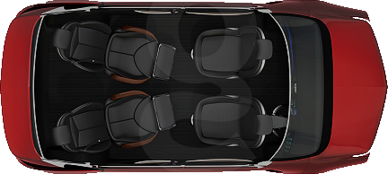
THE USER MOBILITY PROFILE
POSSIBLE EXTENSIONS – INTER-CAR COMMUNICATION
Who has the UMP for ?
EASING THE BURDEN ON THE CLOUD INFRASTRUCTURE
UMPM
To reduce the bandwidth requirements of the cloud service, an ad-hoc network between cars could be put in place, allowing the transfer of data from one vehicle to another as the passengers switch cars.
Carl’s Apps
Config
Carl’s Apps
NOT ONLY PROFILES TRANSFERS
Carl
In addition to transferring the passengers' UMP such inter-car network could also be exploited for transferring the users' suites of applications along with their configurations.
UMPM

Slide 41
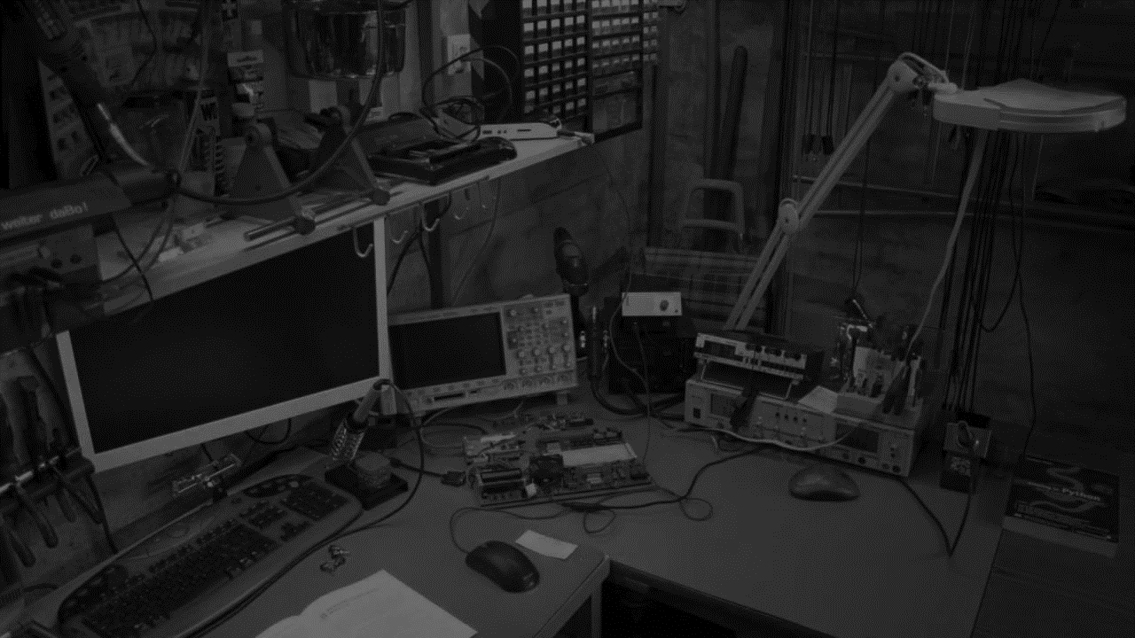
THE USER MOBILITY PROFILE
PROTOTYPE DESCRIPTION

Slide 42
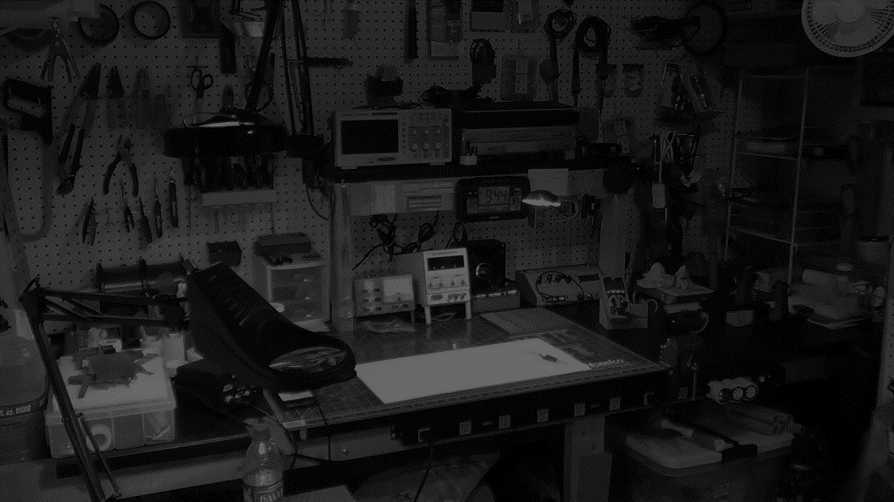

PROTOTYPE ARCHITECTURE
USER MOBILITY PROFILE MANAGER
CLOUD SERVICE
CAR SYSTEM
CAMERA
MICROPHONE
DATABASE CONNECTOR
DATABASE CONNECTOR
raw photo
CAR CONTROL MODULE
raw voice
NEURAL CLASSIFIER
NEURAL CLASSIFIER
INPUT MUX
UMPM MAIN LOGIC
CLOUD MAIN LOGIC
raw input
MONITORING INTERFACE
MONITORING INTERFACE
ID Request
UMP Exchange
SOCKET COMMUNICATION
SOCKET COMMUNICATION
SOCKET COMMUNICATION

Slide 43
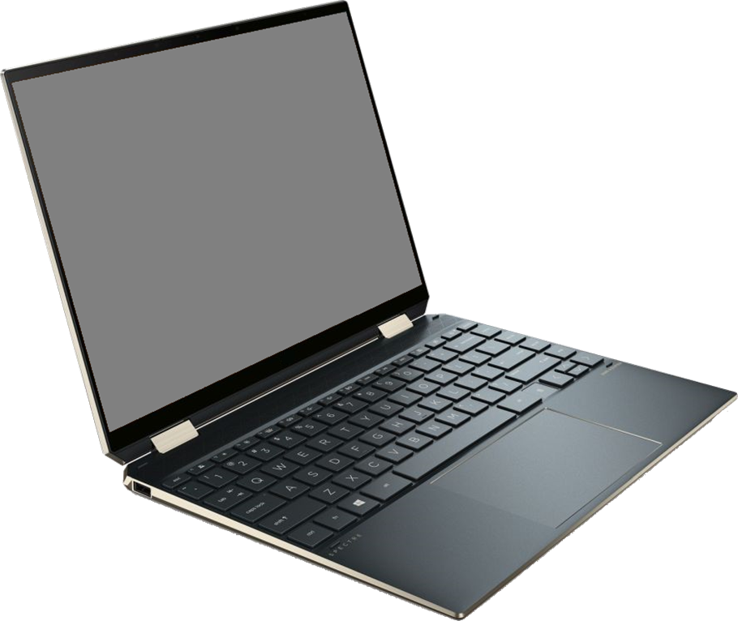
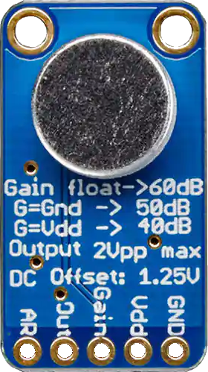
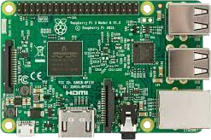
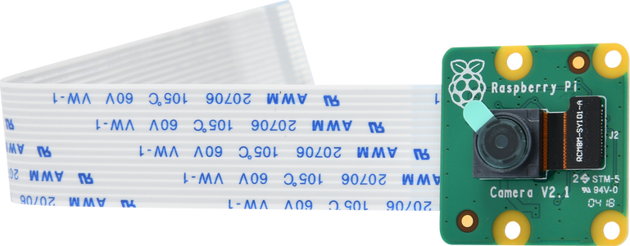



PROTOTYPE HARDWARE DEPLOYMENT
USER MOBILITY PROFILE MANAGER
CLOUD SERVICE
CAR SYSTEM
RASPBERRY PI 3 B+
SUPPORT NOTEBOOK
(WITH PI CAMERA AND MICROPHONE)
CAMERA
MICROPHONE
DATABASE CONNECTOR
DATABASE CONNECTOR
raw photo
CAR CONTROL MODULE
raw voice
NEURAL CLASSIFIER
NEURAL CLASSIFIER
INPUT MUX
ETHERNET CABLE
UMPM MAIN LOGIC
CLOUD MAIN LOGIC
raw input
MONITORING INTERFACE
MONITORING INTERFACE
Auth Request
UMP Request
SOCKET COMMUNICATION
SOCKET COMMUNICATION
SOCKET COMMUNICATION

Slide 44



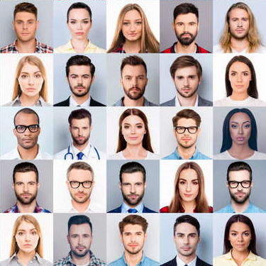



PROTOTYPE IMPLEMENTATION DETAILS
ALL SOFTWARE COMPONENTS WERE IMPLEMENTED USING THE PYTHON LANGUAGE (V 3.6)
MONGODB WAS SELECTED AS THE DBMS FOR STORING THE UMPs, BOTH IN THE UMPM AND IN THE CLOUD
THE DATABASE WAS POPULATED WITH A COLLECTION OF PHOTOS AND VOICE SAMPLES OF THE DEVELOPERS
SPEECH AND FACE RECOGNITION WERE IMPLEMENTED USING THE ACUSTID AND DLIB LIBRARIES RESPECTIVELY

Slide 45
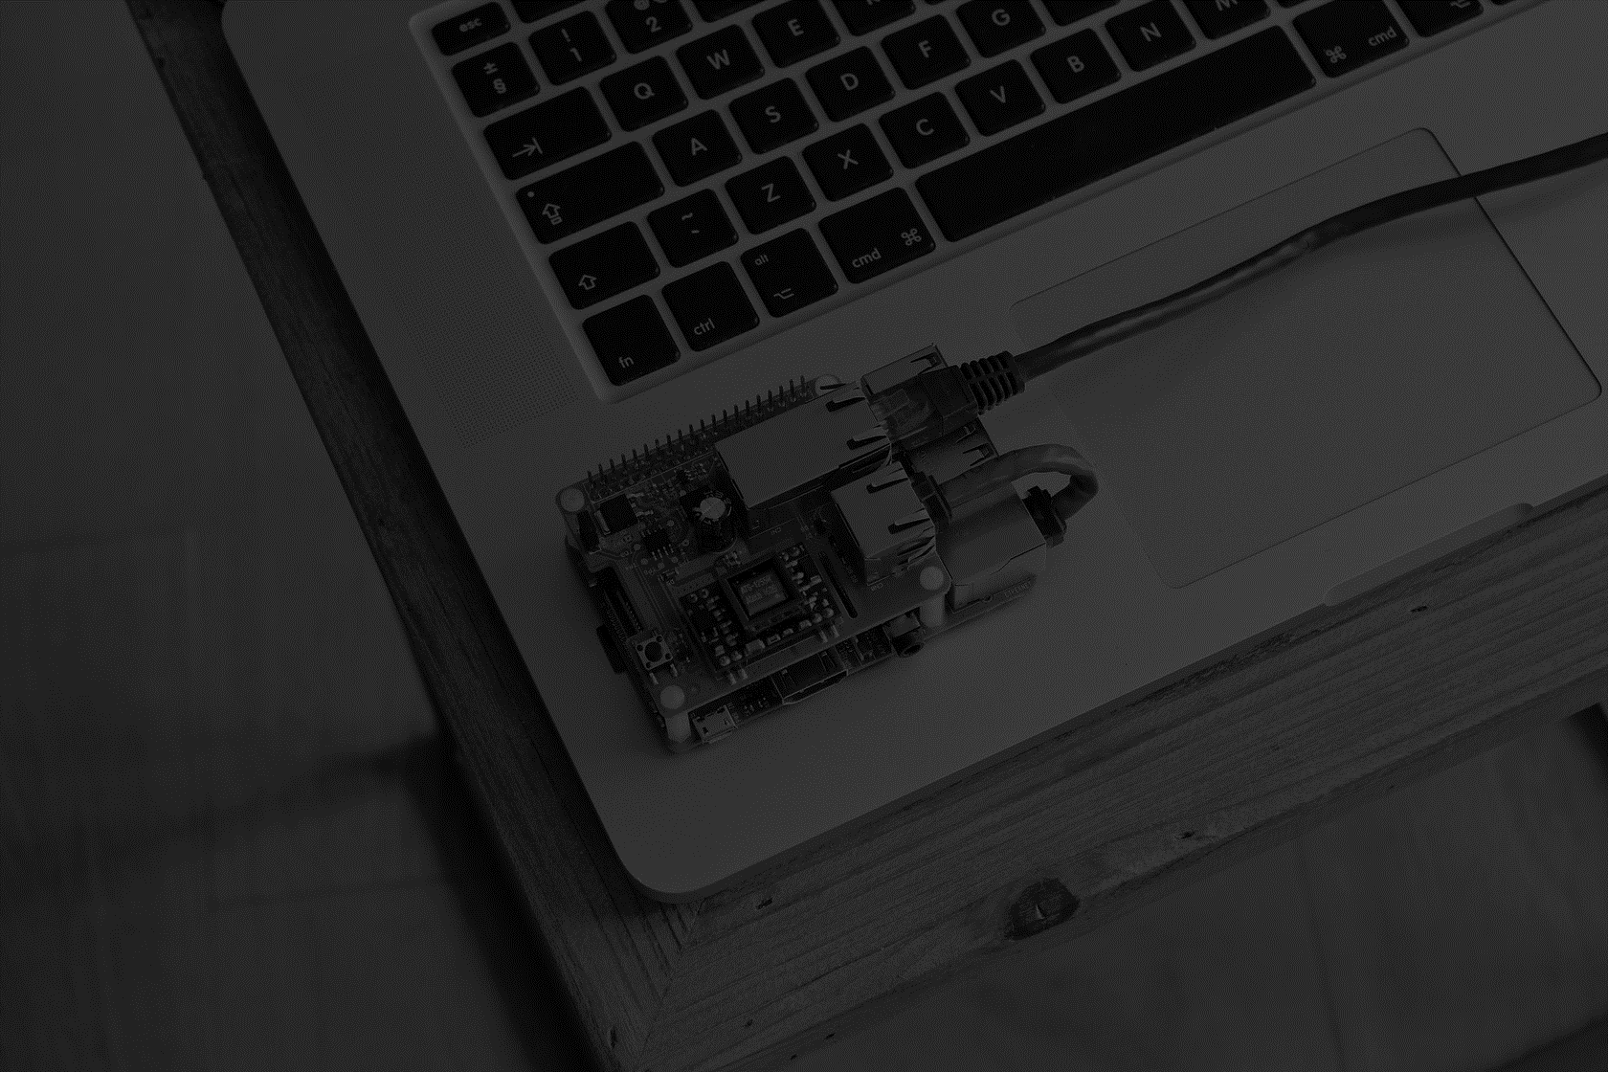
PROTOTYPE DEMONSTRATION

Slide 46

SOME BENCHMARKS
RASPBERRY
NOTEBOOK
FACE RECOGNITION MATCHING TIME
5,54S
1,25S
SPEECH RECOGNITION MATCHING TIME
8,5S
1.94S
USER IDENTIFICATION LATENCY
15 S
AVERAGE CPU UTILIZATION
30%
2%
(4 CORES / 4 THREADS)
(8 CORES / 16 THREADS)
AVERAGE MEMORY UTILIZATION
412MB
637MB

Slide 47

THANK YOU FOR
YOUR ATTENTION

